Slide 1

“Machine learning techniques in sensor based human activity recognition and understanding human actions using still images”
Saura Elghonimi
Eduardo R
Khushboo Agarwal

Slide 2
Data sources
http://www.cis.fordham.edu/wisdm/dataset.php
Raw time series data
Number of examples
1,098,207
Number of attributes – 6
Class Distribution
Walking: 424,400 (38.6%)
Jogging: 342,177 (31.2%)
Upstairs: 122,869 (11.2%)
Downstairs: 100,427 (9.1%)
Sitting: 59,939 (5.5%)
Standing: 48,395 (4.4%)
Transformed
Number of transformed examples: 5,424
Number of transformed attributes: 46
Missing attribute values: None
Class Distribution
Walking: 2,082 (38.4%)
Jogging: 1,626 (30.0%)
Upstairs: 633 (11.7%)
Downstairs: 529 (9.8%)
Sitting: 307 (5.7%)
Standing: 247 (4.6%)
Source – give the information

Slide 3

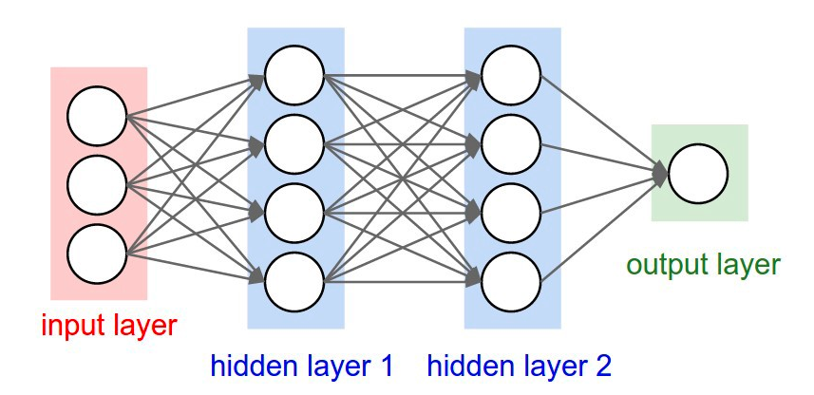
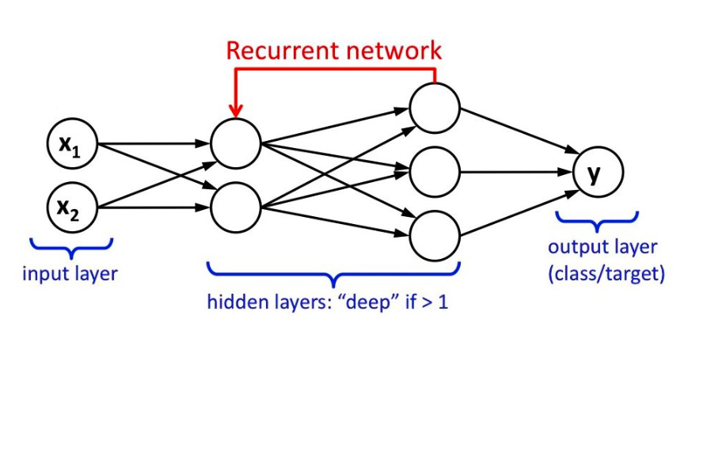
Techniques
Deep Neural Network
LSTM- Long short-term memory/Recurrent Neural Network
Deep Neural Network (DNN)
Image source-http://cs231n.github.io/neural-networks-1/
LSTM
Image source- Towards Data Science, Implementation of RNN,LSTM and GRU Chandra Churh Chatterjee

Slide 4
The algorithm –DNN

